Slide 1


AMAZON’S ALEXA
A VOICE-CONTROLLED VIRTUAL ASSISTANT SCHEMA
GROUP 9: JNANA BOPPANA, THRIKSHA GIRIRAJU, MASOOD HYDER, LAETITIA LE, YASH THAKKAR

Slide 2

Introduction - Project Goal
Ensure data security and integrity while capturing and analyzing key data points like user commands and device usage.
Design a database schema to reduce redundancy, improve query efficiency, and support the integration of new capabilities.
Develop a scalable, secure database system that supports Alexa’s core features and seamless operation.
Notes:
- Develop a scalable, secure database system that supports Alexa’s core features and seamless operation.
- Ensure data security and integrity while capturing and analyzing key data points like user commands and device usage.
- Design a database schema to reduce redundancy, improve query efficiency, and support the integration of new capabilities.

Slide 3
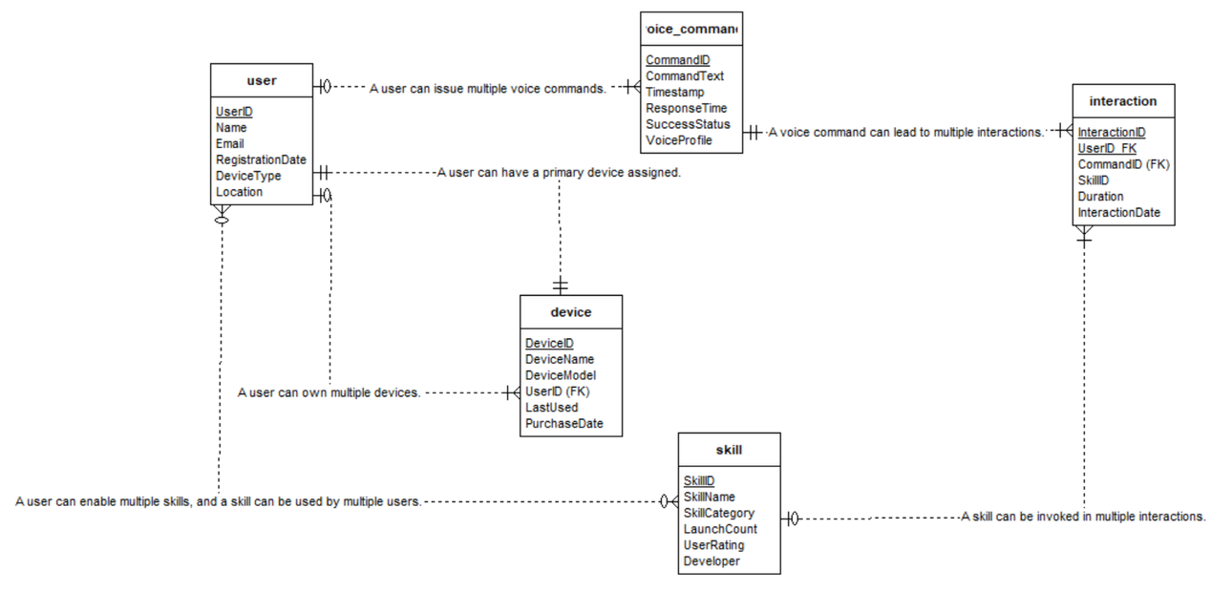
er diagram

Slide 4
Triggers Sequences
TRIGGER
Log User Updates Trigger
CREATE OR REPLACE FUNCTION log_user_update()
RETURNS TRIGGER AS $$
BEGIN
INSERT INTO user_update_log (UserID, UpdateTime, OldValue, NewValue)
VALUES (OLD.UserID, CURRENT_TIMESTAMP, OLD.Name, NEW.Name);
RETURN NEW;
END;
$$ LANGUAGE plpgsql;
CREATE TRIGGER user_update_trigger
AFTER UPDATE ON amazon_alexa.User
FOR EACH ROW
EXECUTE FUNCTION log_user_update();

Slide 5
SEQUENCE
UserID Sequence
Purpose: Automatically generates unique identifiers for the UserID in the User table.
CREATE SEQUENCE user_id_seq START 1 INCREMENT 1;
ALTER TABLE amazon_alexa.User ALTER COLUMN UserID SET DEFAULT NEXTVAL('user_id_seq');
SkillID Sequence
Purpose: Automatically generates unique identifiers for the SkillID in the Skill table.
CREATE SEQUENCE skill_id_seq START 1 INCREMENT 1;
ALTER TABLE amazon_alexa.Skill ALTER COLUMN SkillID SET DEFAULT NEXTVAL('skill_id_seq');

Slide 6
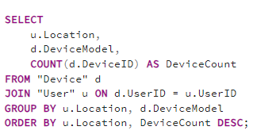
Advanced Queries
QUERY: THE COMPANY WANTS TO FIND OUT WHICH DEVICE MODELS ARE THE MOST POPULAR IN EACH CITY. THIS WILL HELP THEM TAILOR MARKETING AND INVENTORY STRATEGIES BY LOCATION.

Slide 7
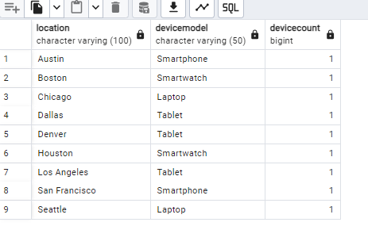
OUTPUT

Slide 8
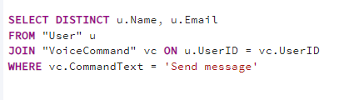
ADVANCED QUERIES
Query: List all users who have used a specific voice command ("Send message")

Slide 9
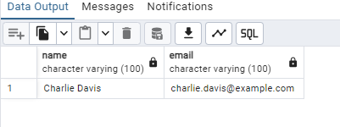
OUTPUT

Slide 10
Amazon’s Alexa - Challenges
Balancing Personalization and Privacy
Responsible Data Usage
Continuous Learning vs. Data Sensitivity
Data Security Measures
Compliance with Privacy Regulations
Building User Trust
Notes:
-Balancing Personalization and Privacy
Ensuring highly customized user experiences while maintaining strict privacy and security standards.
- Responsible Data Usage
Managing vast amounts of data (voice commands, device usage, skill preferences) without compromising user privacy.
- Continuous Learning vs. Data Sensitivity
Enhancing personalization through continuous learning while protecting sensitive user information.
- Data Security Measures
Implementing strong encryption, data anonymization, and giving users clear control over their data.
- Compliance with Privacy Regulations
Adapting to evolving privacy laws (CCPA, GDPR) and updating data handling procedures accordingly.
- Building User Trust
Maintaining user trust by ensuring data security and delivering personalized, intelligent experiences.

